Slide 1


Slide 2

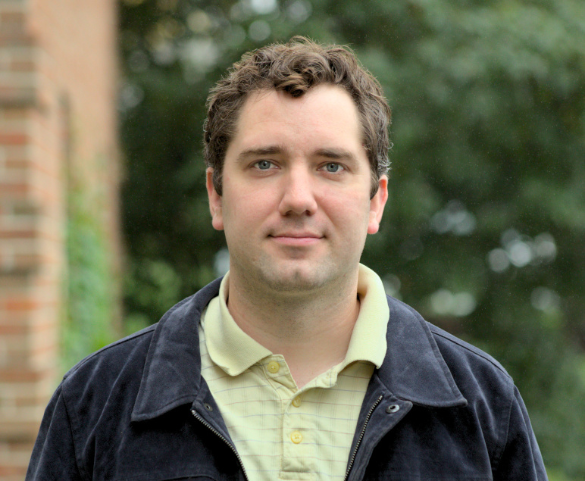
About Me
Nate Moss
DevOpsArtist, Biblicist, Thinker
Systems Engineer for Eberly Systems
Worked in IT for over 12 years
A PK involved in ministry from youth
natemoss.com/EverydayPioneer

Slide 4

Attitudes Toward Technology

Slide 5
Attitudes Toward Technology
Total Rejection

Slide 6
Attitudes Toward Technology
“Ignorant”
Total Rejection

Slide 7
Attitudes Toward Technology
Casual Enthusiasm
“Ignorant”
Total Rejection

Slide 8
Attitudes Toward Technology
Intentional Technology User
Casual Enthusiasm
“Ignorant”
Total Rejection

Slide 10


What a Pioneer Needs

Slide 11


What Threat Actors are Motivated by

Slide 12

85% of Breaches Involve “the Human Element”
https://www.radarfirst.com/blog/incidents-breaches-and-the-human-factor/

Slide 13

Examples of Cyber Deception

Slide 14
Email Phishing
https://www.thesslstore.com/blog/phishing-email-examples-the-best-worst/

Slide 15

Vishing

Slide 16
Spear Phishing
https://www.imperva.com/learn/application-security/spear-phishing/

Slide 17
Whaling
https://www.agari.com/blog/whaling-phishing-email-fraud

Slide 18
Smishing
https://www.proofpoint.com/us/threat-reference/smishing

Slide 19
Credential Harvesting
https://www.avanan.com/blog/new-credential-harvesting-scam-spoofs-microsoft

Slide 20


Pharming
intercepted
MyFavoriteWebsite.com

Slide 21


Social Engineering

Slide 22
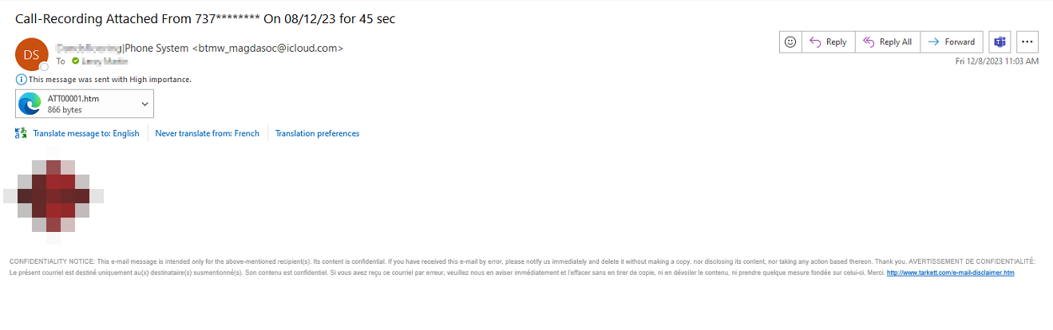
Clone Phishing

Slide 23
Search Engine Phishing
https://www.keepersecurity.com/blog/2023/04/12/what-is-search-engine-phishing/

Slide 24
Malicious Browser Extensions
https://www.geoedge.com/university/malicious-browser-extensions/

Slide 25
Quizzes and Surveys
https://www.malwarebytes.com/blog/news/2018/12/online-quiz-now-confirmed-phishing-scam

Slide 26
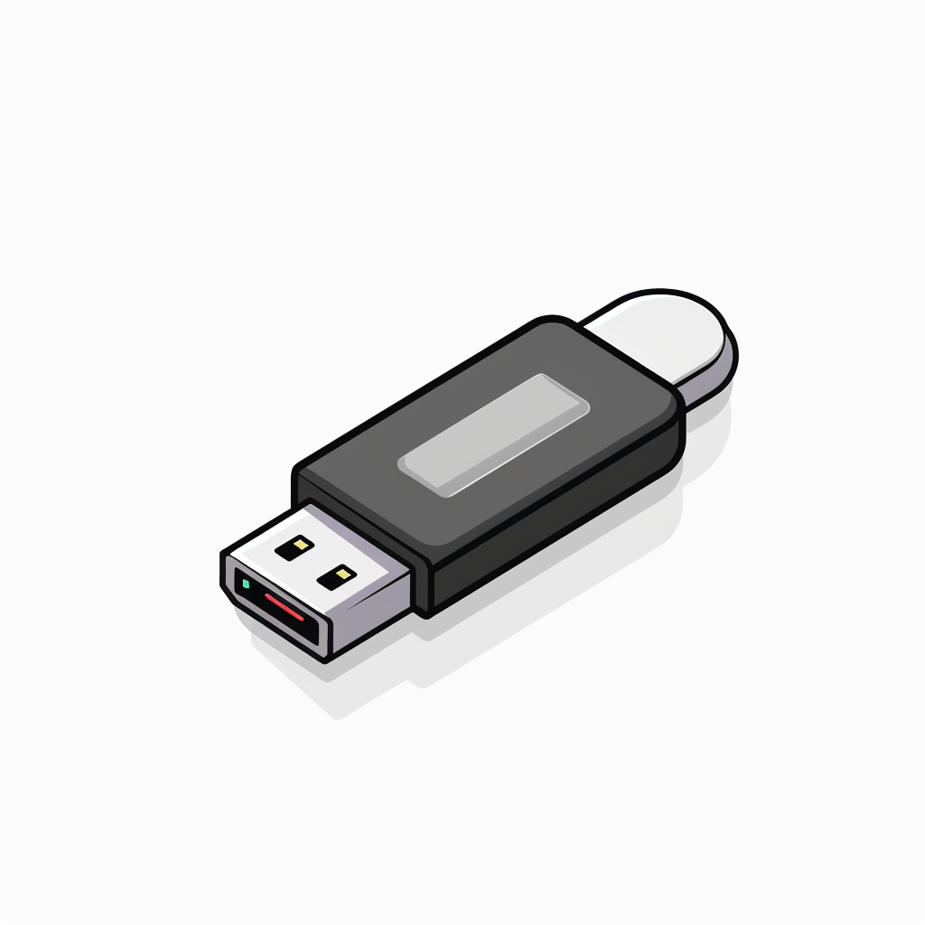
USB Baiting

Slide 27
Malvertising and Scareware
https://www.avast.com/c-scareware

Slide 28
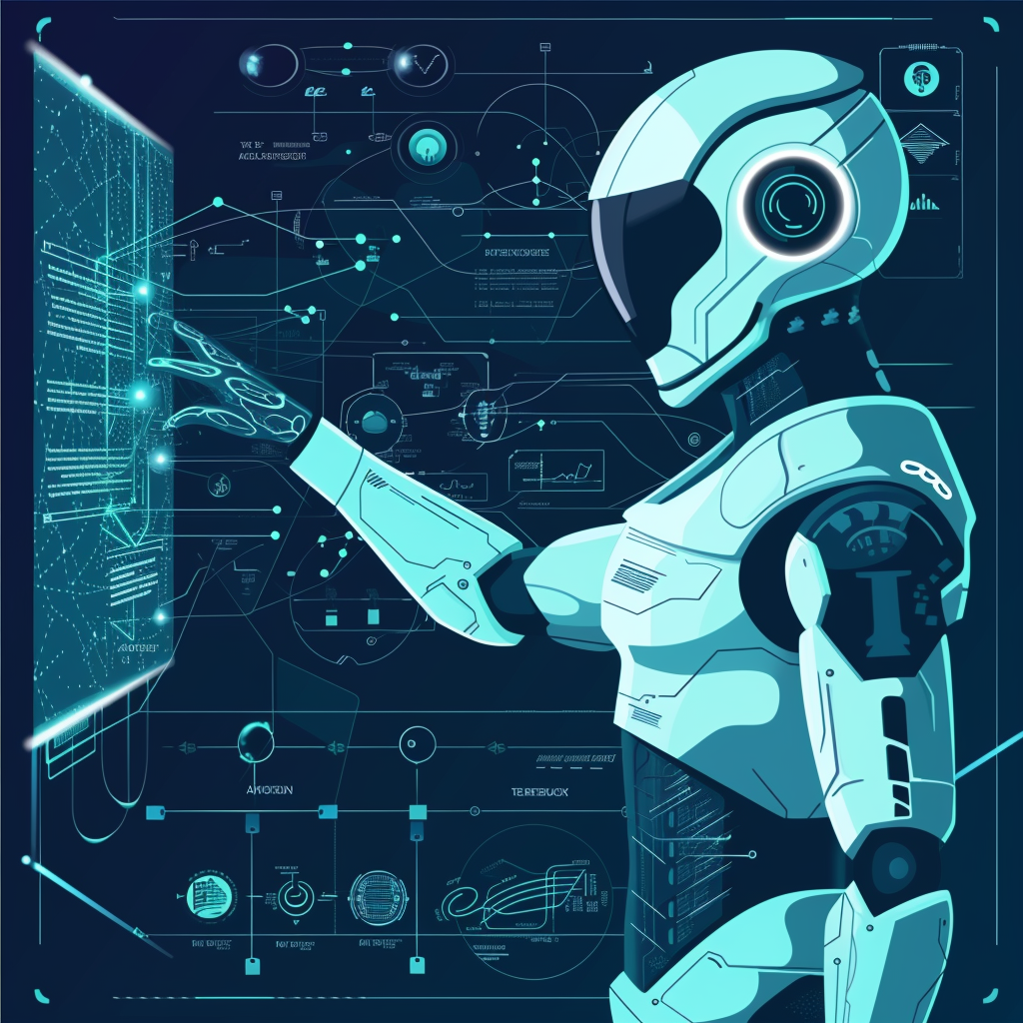
How AI Is Likely To Evolve These Threats

Slide 29

Human Spoofing

Slide 30

Spear Phishing Will Get More Sophisticated

Slide 31
Attitudes Toward Technology
Intentional Technology User
Casual Enthusiasm
“Ignorant”
Total Rejection

Slide 32



The Transformative Power of Technology

Slide 33

The Prime Target: Your Account

Slide 34




Password Manager

Slide 35

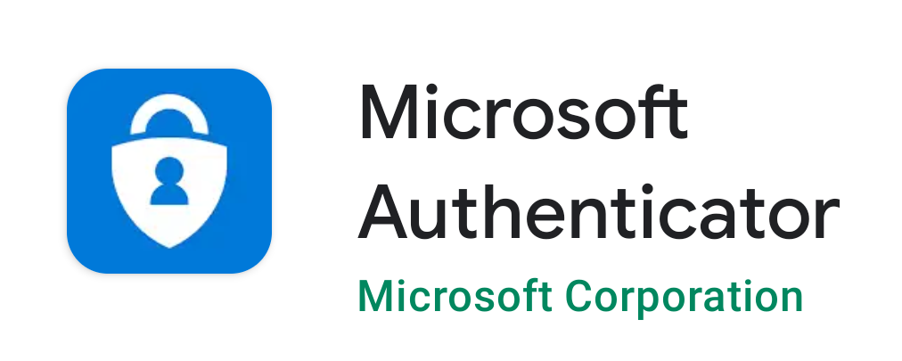


MFA (Multi-Factor Authentication)
Your Favorite Password Manager

